Slide 1
Event Spotting in Soccer Games
Guide : Dr.S.Sudha
Team Members : Hari Krishna Nagarajan 2015103017
Sreevatsan Agoramurthy 2015103023
Sribashyam Sriranjan Srinivas 2015103049

Slide 2
Introduction
Difficulty in spotting events in soccer matches –
Duration of the game
Coarse grained nature of the game
Our attempt – Spotting events in videos of soccer matches
‘Spotting’ = Finding anchors of events in soccer videos
Events
Goal Foul Substitution

Slide 3
OBJECTIVES

Slide 4
INTRODUCTION

Slide 5
Objectives
To analyze the video database containing over 500 hours of soccer match footage and ‘spot’ events.
To classify these events , that have been spotted using activity recognition techniques, into three classes, namely:
Substitution
Card
Goal
To develop a model that can perform localization of very-sparse events in long videos and annotate them accordingly.

Slide 6
LITERATURE SURVEY

Slide 7
Literature Survey
REF. NO | YEAR | PAPER TITLE | METHODOLOGY USED | IDEAS FOR ADOPTION | ISSUES/GAPS
[1] | 2014 | Multimodal feature extraction and fusion for semantic mining of soccer video: a survey | Providing a framework for audio, video analysis especially of soccer videos | Defines methods to eliminate need of human intervention for video analysis
[2] | 2015 | Jersey number detection in sports video for athlete identification | Using K-NN to identify a number between 0-9 | It provides efficient results with minimal redundancy by using K-NN. | Not as accurate as a Neural Network
[3] | 2016 | Event boundary detection using audio-visual features and Web-casting texts with imprecise time information | Using features when the feed is web-casted and using audio visual features | Match time stamp of the video and the game footage

Slide 8
REF. NO | YEAR | PAPER TITLE | PROPOSED TECHNIQUE | IDEAS FOR ADOPTION | ISSUES/GAPS
[4] | 2015 | Deep Residual Learning for Image Recognition | Link back layers to learn from previous layers , instead of learning from unreferenced functions | Makes training neural networks with larger number of layers easier. Idea to use ResNet.
[5] | 2015 | A Novel Framework for Semantic Annotation and Personalized Retrieval of Sports Video | Instead of using audio visual features, rely on the web-casting text analysis | Idea to include both web based features and real time features | Data hard to procure

Slide 9
SUMMARY OF ISSUES

Slide 10
Summary of Issues
Collection of the dataset and the preprocessing of it.
Standardizing video footage.
Synchronization of video footage & timestamp.
Variety of options available for feature extraction.
Very large size of features – 5024*512.

Slide 11
PROPOSED SYSTEM

Slide 12
Proposed System
We collect the video footage of games and edit them to match our requirements.
We also crawl the internet using APIFootball and get match reports for the corresponding videos.
We then use ResNet instance to generate all the frame features for our videos.
Since the dimensions of the frame feature for each video is very big, we use PCA in order reduce it.
After obtaining the reduced frame features we then feed into a Neural Network along with the annotations of the events and build a model that will learn each event.
We can then use this model to predict the classes.

Slide 13
SYSTEM ARCHITECTURE

Slide 14
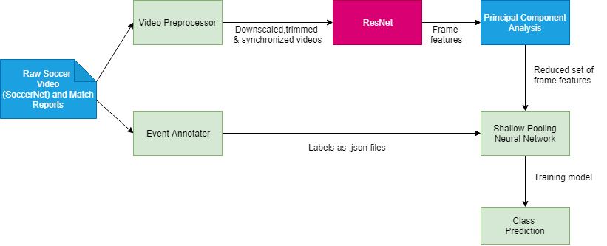
System architecture

Slide 15
MODULE DESCRIPTION

Slide 16
Video Preprocessor
Input: Raw video footage of soccer games
Output: Two 45 min halves of the soccer game in drive
Psuedocode:
Trim the video to 224x224 resolution
Using Adobe Premium Pro, remove the media coverage and replays present in the footage; the timestamp in the video should match with the actual in-game time
Color correct the videos as different soccer leagues have different color schemes and we need uniformity through all the videos
Set the frame rate to 25 frames/second

Slide 17
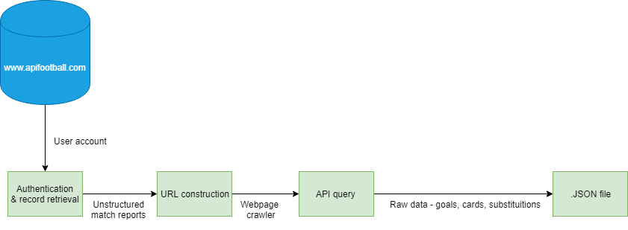
Event Annotator
Input: Python script with API to crawl the web
Output: .JSON files containing event time stamps
Psuedocode:
Register with www.apifootball.com.; get authentication key
API endpoint has following parameters: League ID, Date_from & Date_to, Team_Name
Build the URL using get-record() function (send parameters here)
Query the API to collect the details of the soccer game
Define three separate functions- getcards(), getgoals(), getsubstitutions() in order to seperate only the relevant data

Slide 18
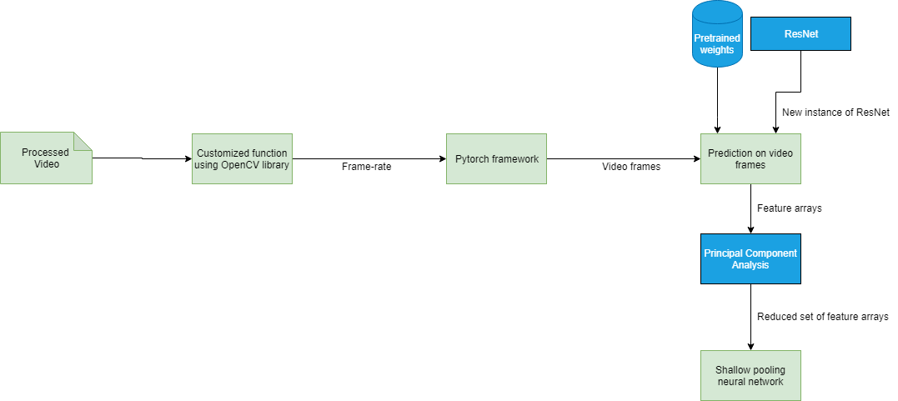
ResNet
Input: 45min video
Output: Frame features for the video
Pseudocode:
We use getFPS() in order to get the FPS of the video
GetVideoFrames() to get the video frame arguments: VideoPath, GameStartIndex, GameEndIndex, Height, Width using the handlers such as OpenCV or SciKit-Learn
The output will be 4D Numpy array per second of a video reading the metadata
Create an instance of ResNet with input as dimensions of video frames and output as the fc1000 layer in ResNet
We choose every 25th frame basically meaning the frame after every second
Using resnet, predict values on the set of the frames
Return feature arrays

Slide 19
Principal Component Analysis
Input: 5.5M feature array
Output: Feature array with reduced dimensionality
Since there are 2048 feature per single frame the number of total frame features are 5.5 million features (2048 frame features * 60 seconds * 45mins)
Therefore we use PCA to reduce the dimension to 512 features

Slide 20
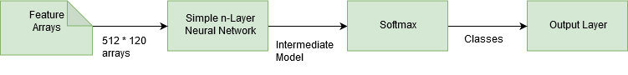
Shallow Pooling Neural Network
Input: Frame features of the video
Output: A model that we can use to predict the type of event
Pseudocode:
Find features which correspond to event times extracted from annotated Match Reports
Feed it through a simple Neural Network with very few layers
Sigmoid Activation Layer, Adam optimizer minimizing binary cross-entropy loss function
Evaluate output using mAP(mean average Precision)

Slide 21
IMPLEMENTATION DETAILS

Slide 22
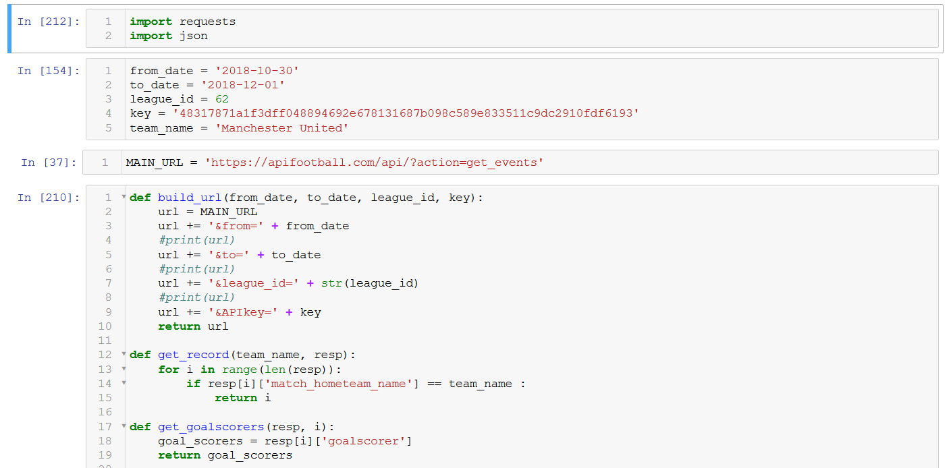
Implementation Details
Screenshot of algorithm for using the APIFootball

Slide 23
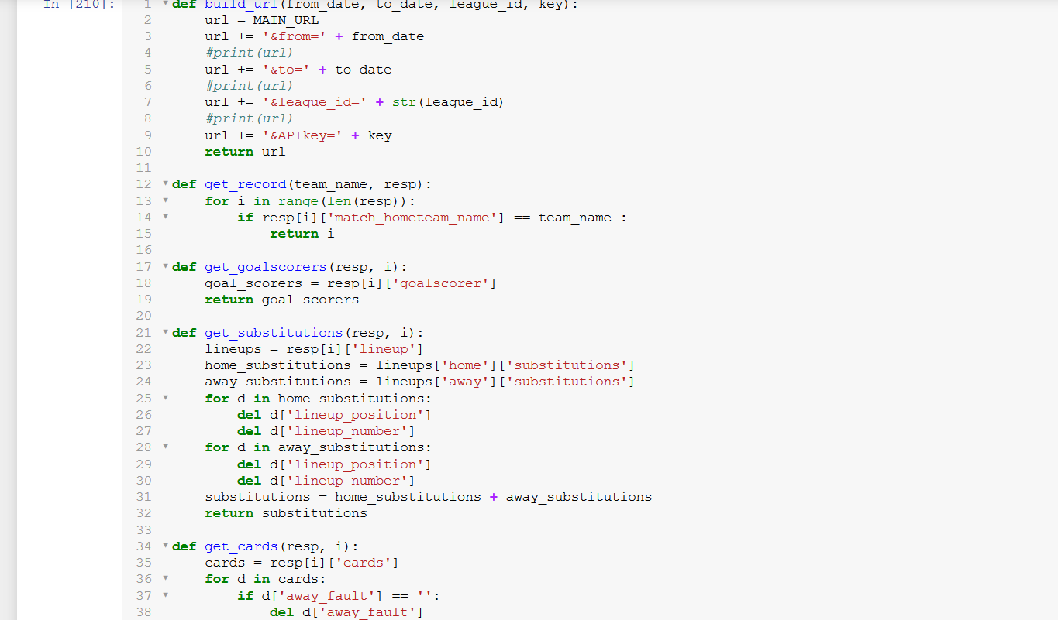
Screenshot of functions for getting the relevant details from the crawled data

Slide 24
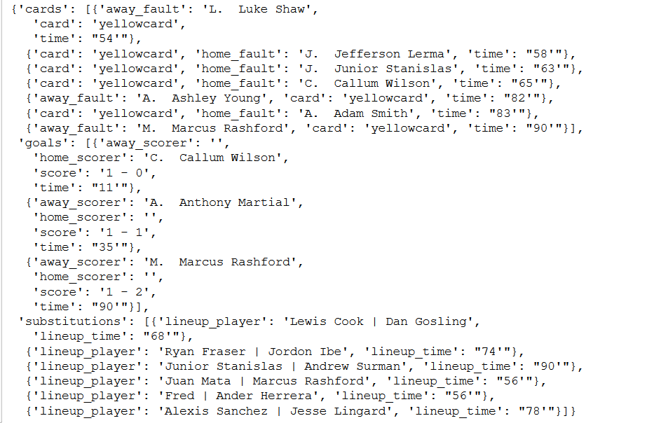
Screenshot of the records obtained, each event mentioned has a timestamp along with it

Slide 25
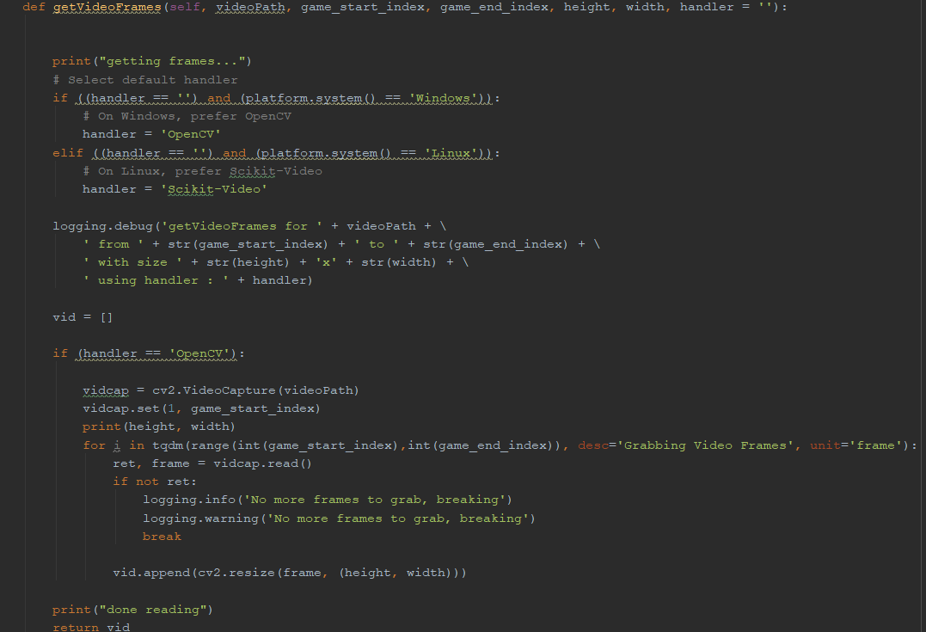
Function - Extracting video frames

Slide 26
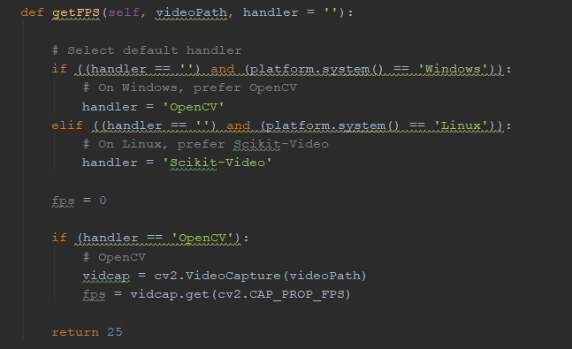
Function - Obtaining FPS

Slide 27
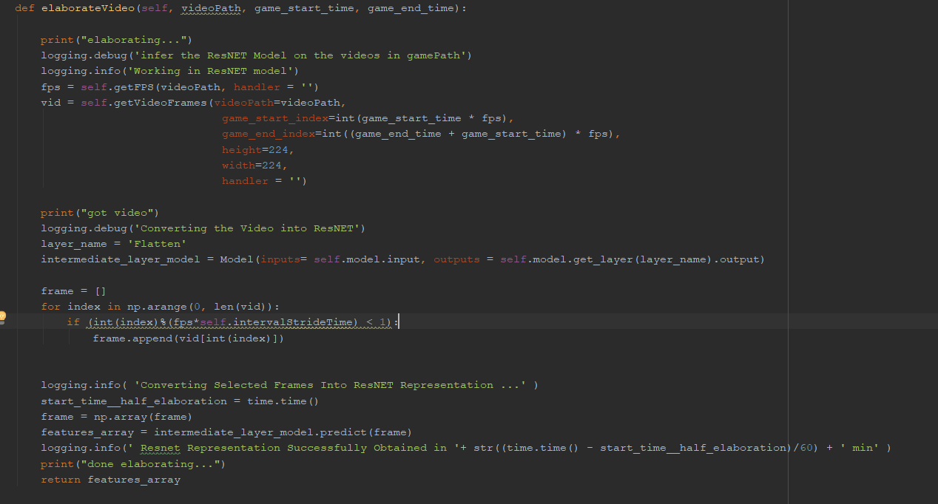
Function - Extracting frame features

Slide 28
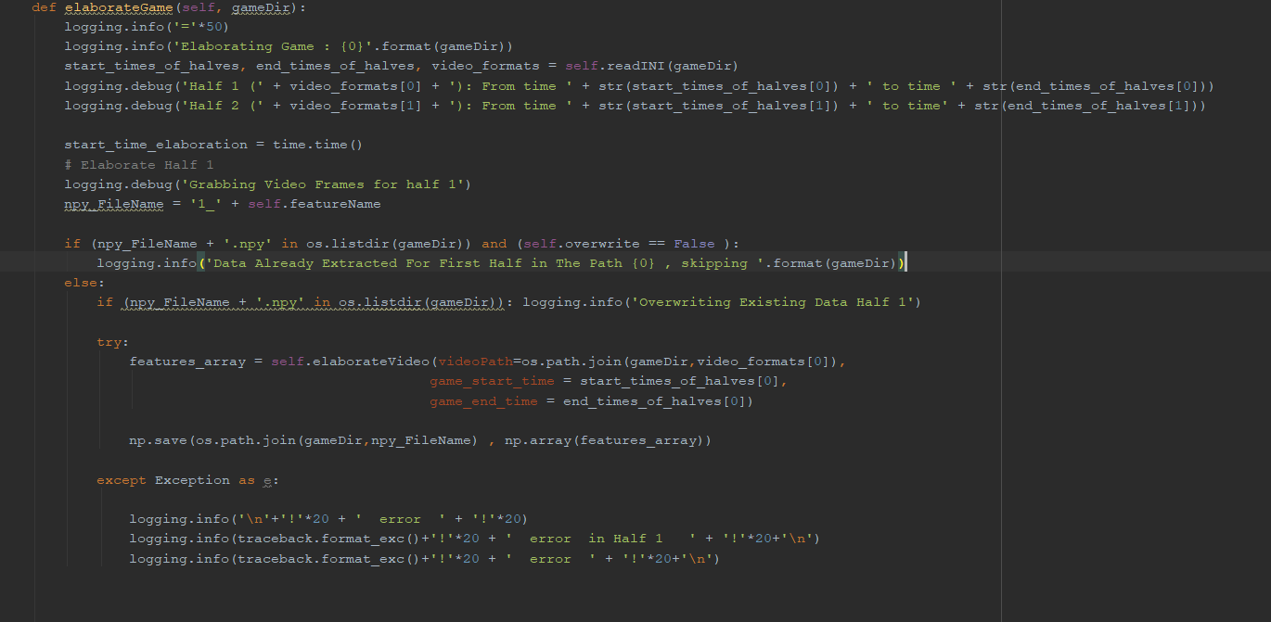
Function – Extracting frame features

Slide 29
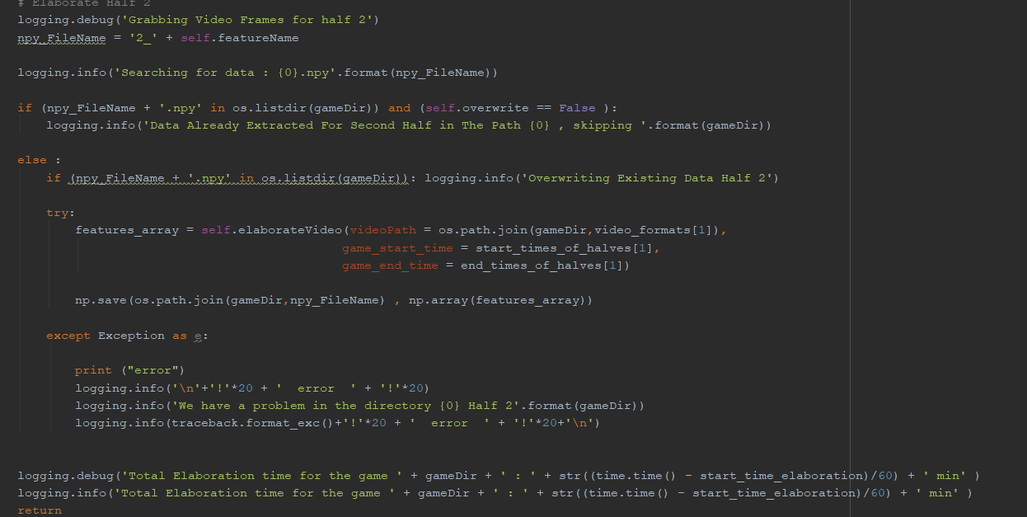

Slide 30
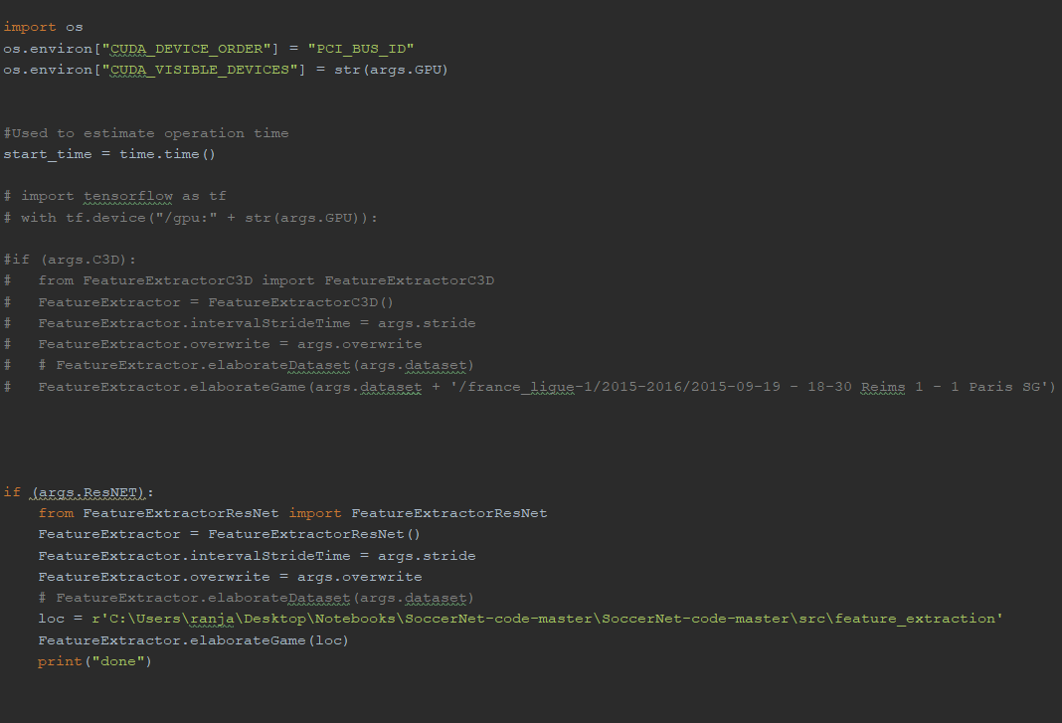
Function – Main Function

Slide 31
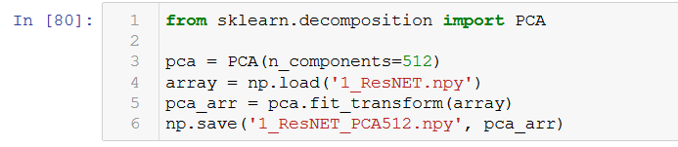
Function – Principal Component Analysis

Slide 32
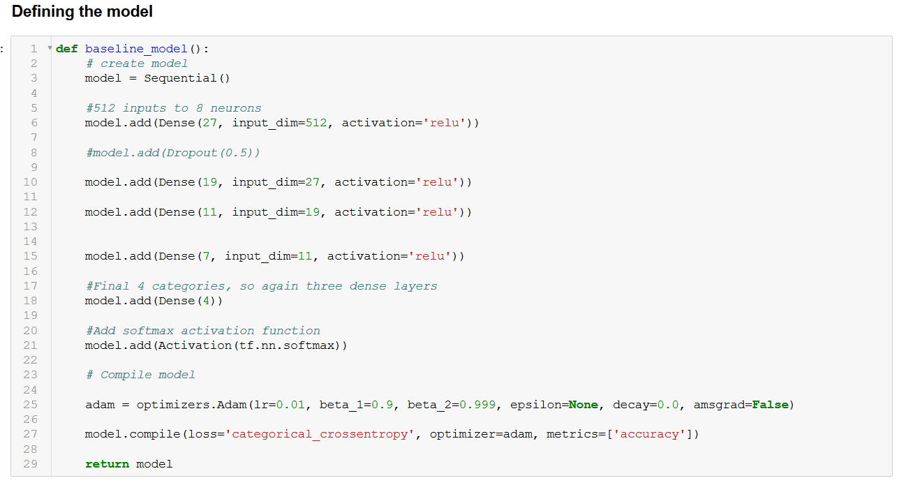
Function – Model definition

Slide 33
TESTCASES

Slide 34
Testcases
No event occuring : "No event has occurred“
Goal : "Goal“
Substitution : "Substitution“
Duration of video > 2minutes : "Video too long“
Format of video is not .mkv : "Video codec cannot be parsed"

Slide 35
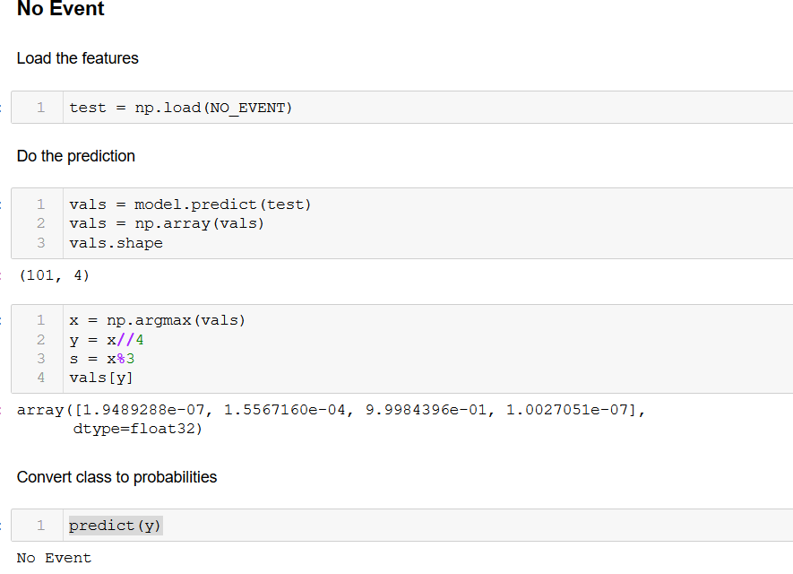
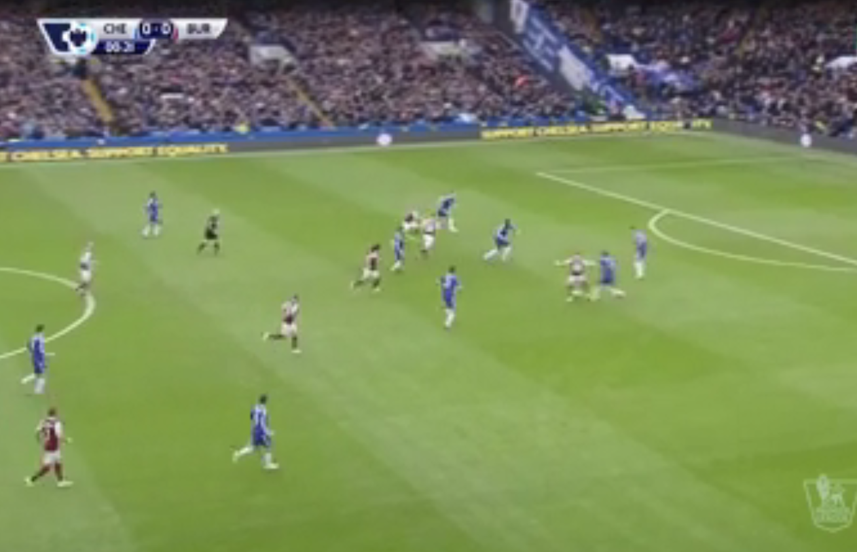
No event occurring
INPUT
OUTPUT

Slide 36
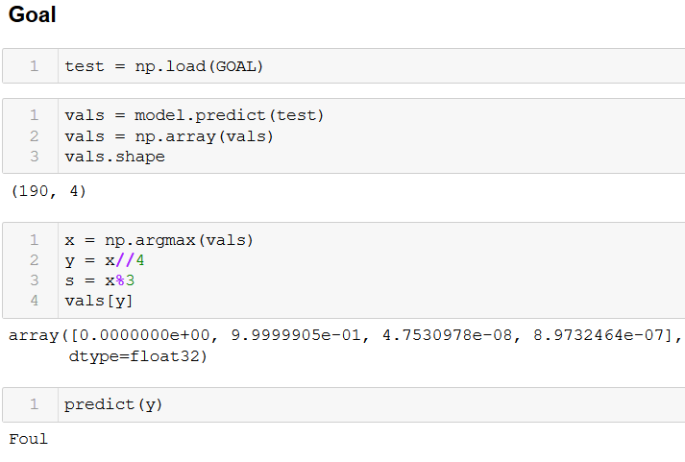
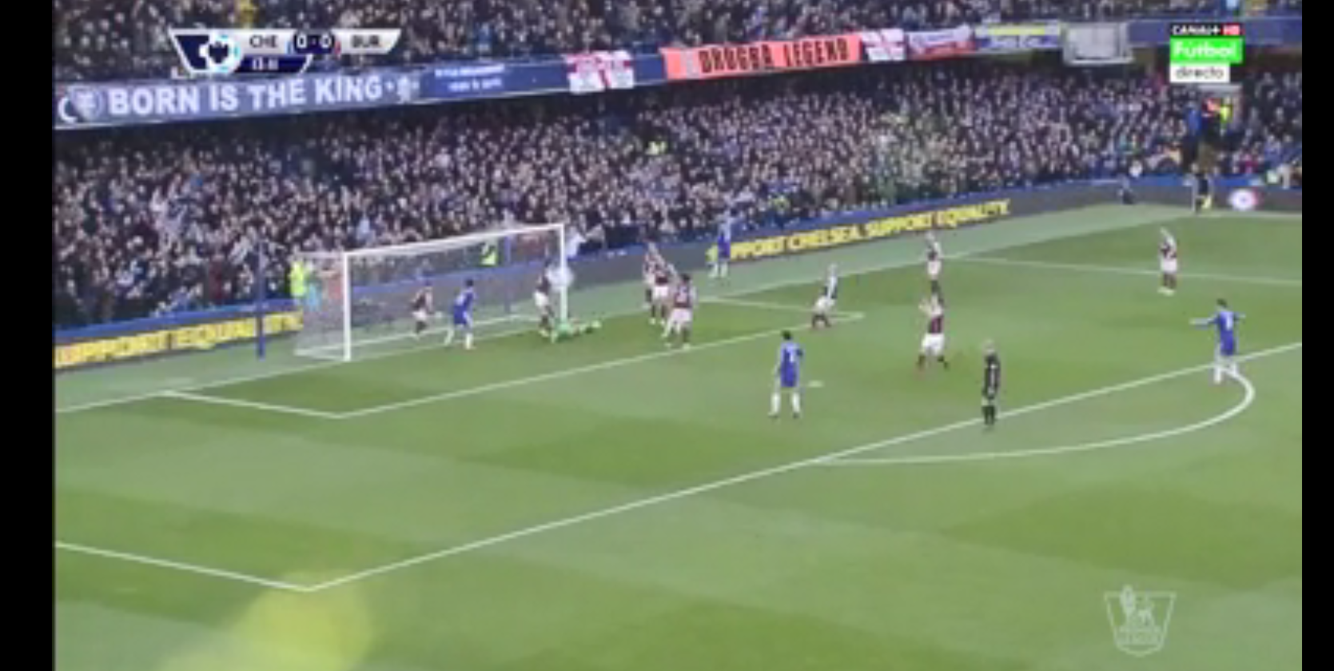
Goal
INPUT
OUTPUT

Slide 37
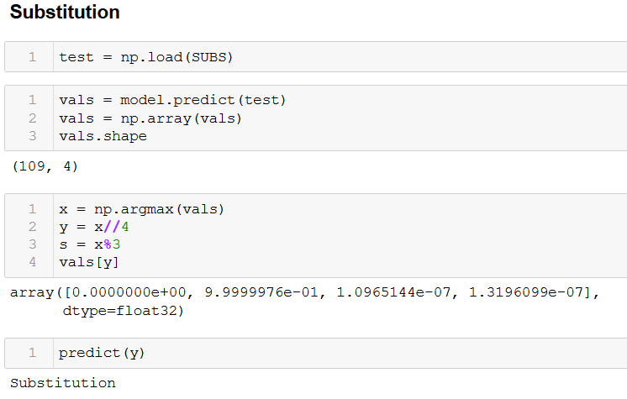
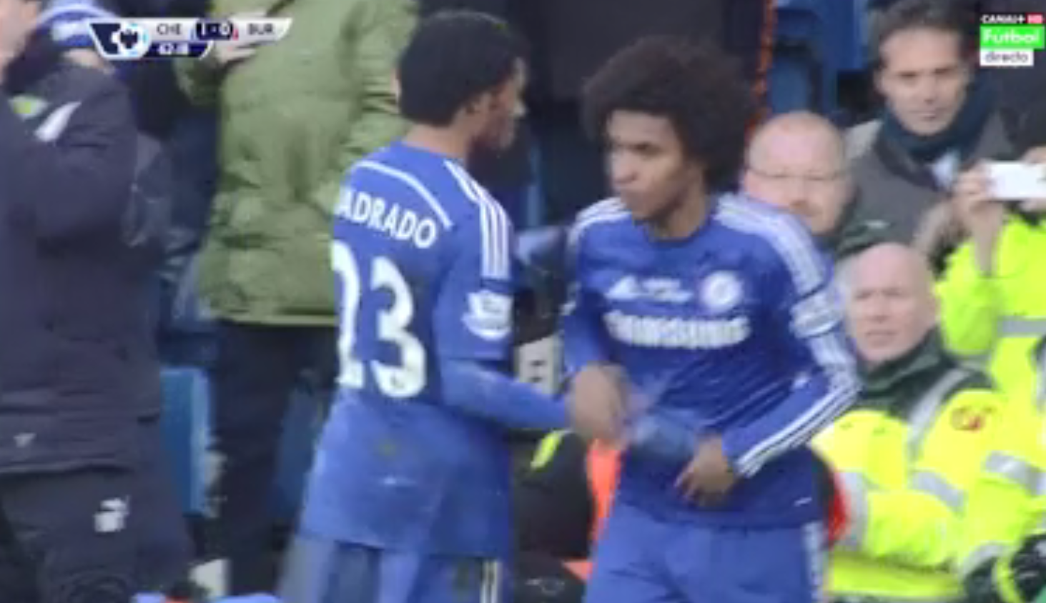
Substitution
INPUT
OUTPUT

Slide 38
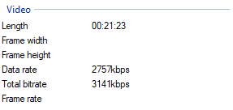
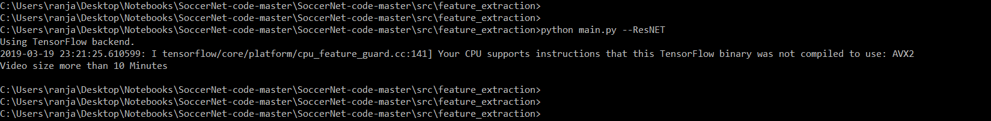
Duration too long ( > 10 minutes )
INPUT
OUTPUT

Slide 39
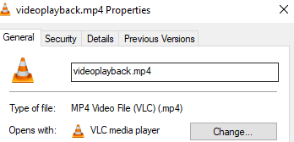
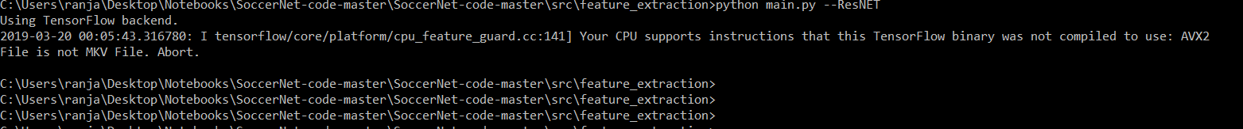
Wrong Codec
INPUT
OUTPUT

Slide 40
PERFORMANCE METRICS

Slide 41
Performance Metrics
For evaluation of our model we calculate the Recall, Precision and mean Average Precision for each class of event identified and also a mean Average Precision over all the classes.
Recall = True Positives/(True Positives+ False Negatives)
Precision = True Positives/(True Positives+ False Positives)
Accuracy = (True Positives + True Negatives)/Total

Slide 42
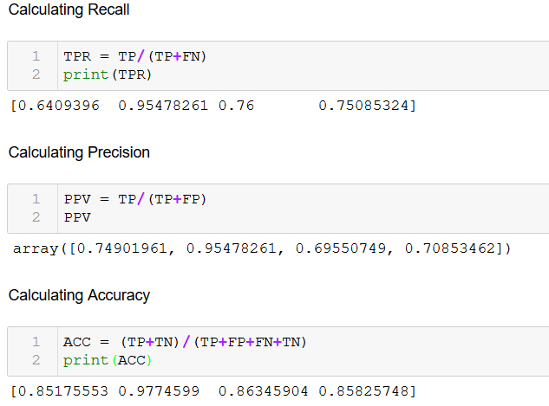
Performance Metrics

Slide 43
Dataset
We use the SoccerNet Dataset consisting of video footage from soccer games across the top five leagues in Europe along with European Cups. The dataset used comes in two variations, one of about 119 GB, of lower quality. The other of Higher quality, of > 2TB in size. The accompanying labels of the dataset. Dataset would be video feeds of games, annotated by the labels.

Slide 44
RESULTS

Slide 45
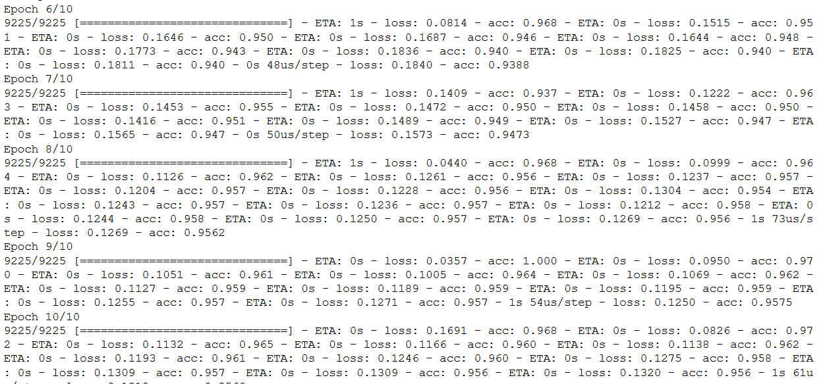
Training Accuracy

Slide 46
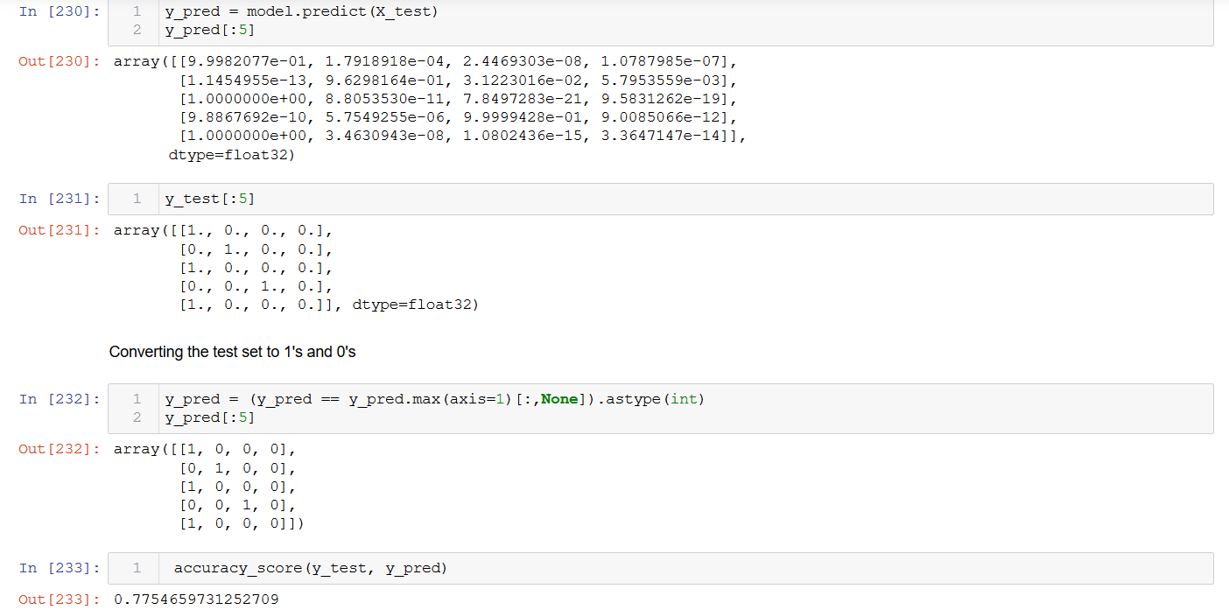
Testing Accuracy

Slide 47
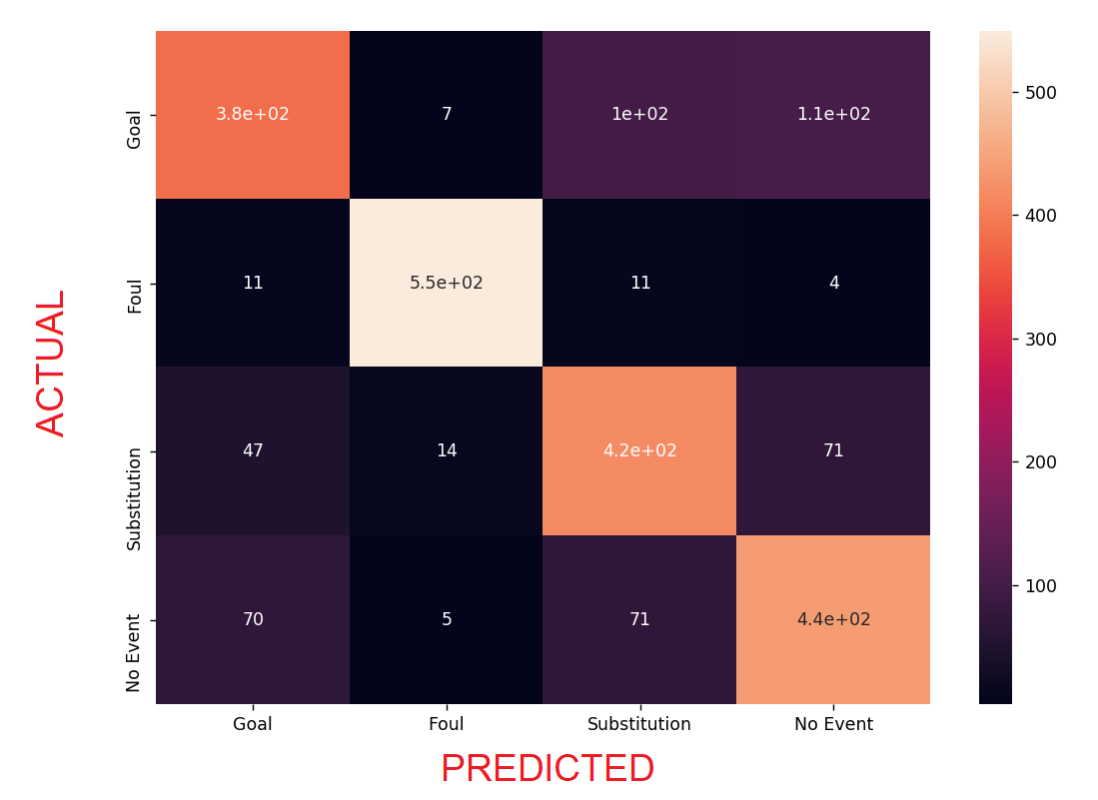
Confusion Matrix
False Negatives

Slide 48
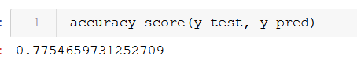
Overall Accuracy

Slide 49
REFERENCES

Slide 50
References
P. Oskouie, S. Alipour, and A.-M. Eftekhari-Moghadam, “Multimodal feature extraction and fusion for semantic mining of soccer video: A survey,” Artif. Intell. Rev., vol. 42, no. 2, pp. 173–210, 2015.
Q. Ye, Q. Huang, S. Jiang, Y. Liu, and W. Gao, “Jersey number detection in sports video for athlete identification,” Proc. SPIE, vol. 5960, pp. 1599–1606, May 2015.
M1. Boyar, Ö. Alan, S. Akpinar, O. Sabuncu, N. K. Çiçekli, and F N. Alpaslan, “Event boundary detection using audio-visual features and Web-casting texts with imprecise time information,” in Proc. IEEE Int. Conf. Multimedia Expo (ICME), Jul. 2014, pp. 578–583.

Slide 51
C. Xu, J. Wang, H. Lu, and Y. Zhang, “A novel framework for semantic annotation and personalized retrieval of sports video,” IEEE Trans. Multimedia, vol. 10, no. 3, pp. 421–436, Apr. 2014.
C. Xu, J. Wang, K. Wan, Y. Li, and L. Duan, “Live sports event detection based on broadcast video and Web-casting text,” in Proc. 14th Annu. ACM Int. Conf. Multimedia, 2015, pp. 221–230.
H. Xu, T.-H. Fong, and T.-S. Chua, “Fusion of multiple asynchronous information sources for event detection in soccer video,” in Proc. IEEE Int. Conf. Multimedia Expo (ICME), Jul. 2005, pp. 1242–1245.
Y. Gong, L. T. Sin, C. H. Chuan, H. Zhang, and M. Sakauchi, “Automatic parsing of TV soccer programs,” in Proc. IEEE Int. Conf. Multimedia Comput. Syst., May 1995, pp. 167–174.
X. Qian, H. Wang, G. Liu, and X. Hou, “HMM based soccer video event detection using enhanced mid-level semantic,” Multimedia Tools Appl., vol. 60, no. 1, pp. 233–255, 2012.

Slide 52
H. Pan, P. van Beek, and M. I. Sezan, “Detection of slow-motion replay segments in sports video for highlights generation,” in Proc. IEEE Int. Conf. Acoust., Speech, Signal Process. (ICASSP), vol. 3. May 2001, pp. 1649–1652.
Y. Yang, S. Lin, Y. Zhang, and S. Tang, “Highlights extraction in soccer videos based on goal-mouth detection,” in Proc. 9th IEEE Int. Symp. Signal Process. Appl., Feb. 2007, pp. 1–4.
Y. Li, G. Liu, and X. Qian, “Ball and field line detection for placed kick refinement,” in Proc. Goal Congr. Intell. Syst., May 2009, pp. 404–407.

